Slide 1

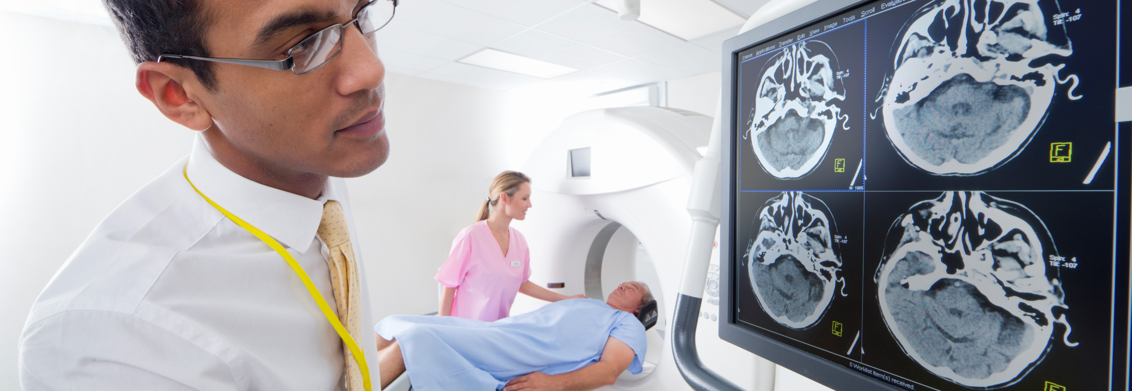

X Ray Image Classifier
Notes:
(Note: these notes are to share methodology and were not used for memorization or read during presentation, they are for tying story with a thread and baseline for practice sessions)
Hi ____ ! thank you for joining me today! =^_^=
-----
Focus on knee X-ray images and their osteo-arthritis grade

Slide 2
Problem Statement
Osteoarthritis Grade for Knee X Ray Images
0 - Healthy
1 - Low Risk
2 - High Risk / Severe
Notes:
Also know as arthritis of joints, most common type of arthritis
Tissues connecting the bones start to degenerate, which is an important clue when we start looking at X-ray images
It is not reversible but is something that can be maintained or slowed down
Low-Risk can be doubtful and or minimal risk, the main focus for us is catching high-risk cases

Slide 3
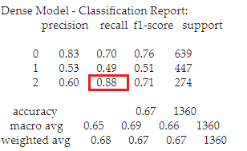
Executive Summary
88% of High-Risk Test Cases Caught
Low Risk Cases were most confusing
Notes:
Almost 90% of high risk cases caught
Model struggled with low-risk cases, this label seems to be more of a range thank clear cut
While most are quite similar to healthy cases some less so and show signs of concern.

Slide 4
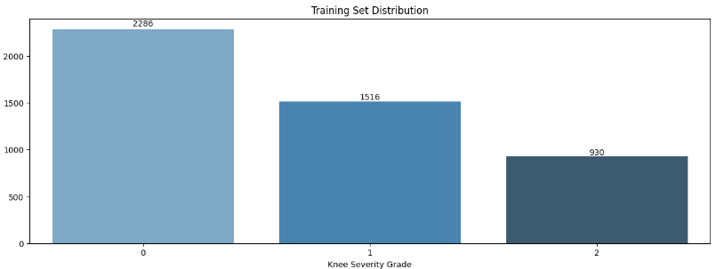
Data Load
Total Images:
6765 Images
Training Images:
4732 Images
Notes:
Incoming data was quite clean and well organized
We check file formats to make sure all files are valid image files
70% of total images were used to train the model
Remaining images 1/3rd used to validate our model while training and 2/3rd used for testing after training, as completely new images for our model

Slide 5
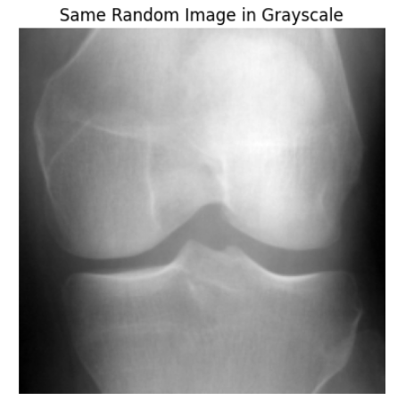
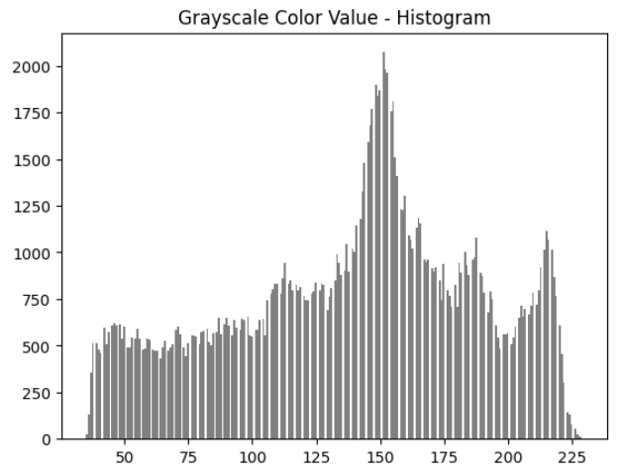
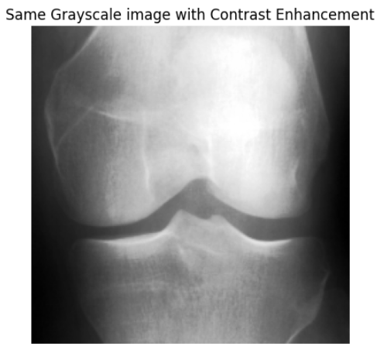
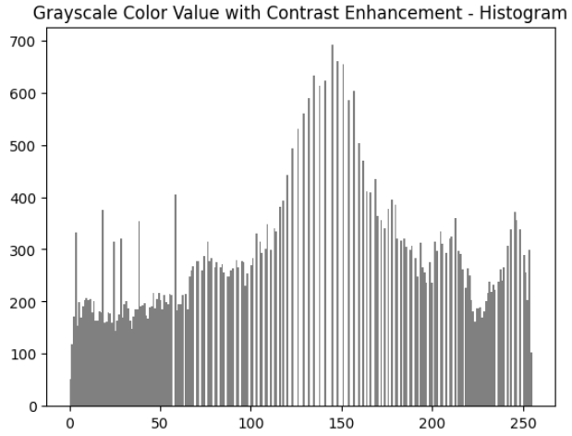
Image
Labelled Images
Image Size
224 x 224
Notes:
Not only images came divided into 3 sets
They also had labels indicating them as healthy, low-risk or high-risk
All images were in same size of 224x224 pixels

Slide 6
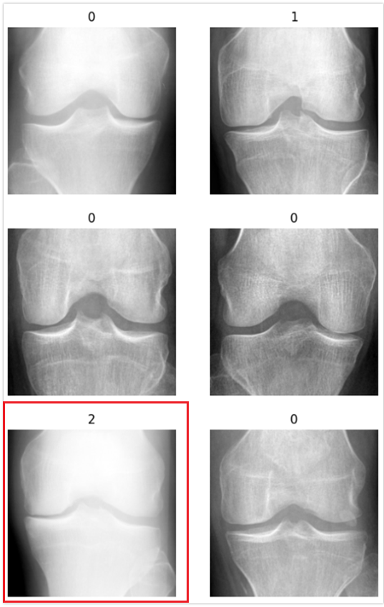
Exploring Sample Images
Biggest Indicator
The Gap Between Bones
Notes:
Here we explored a collection of sample images across all labels,
If you look at the image at bottom left in red box, this is a high-risk or severe image. Due to loss of the tissue, gap between bones is much lower than a healthy x-ray.

Slide 7
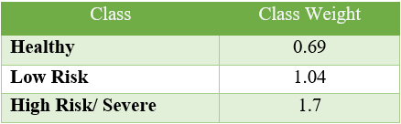
Preparing Images for Modeling
Scale the Images
Generators
Class Weight
Notes:
Scale the images to have color values between 0 and 1 this allows model to converge faster, it also improves performance of models and make them more stable
(best path to peak accuracy)
Generators batch size of 32 to load images while modeling
And finally, we used class weight to tell model to pay more attention to classes with lower images, to have a more balanced training.

Slide 8
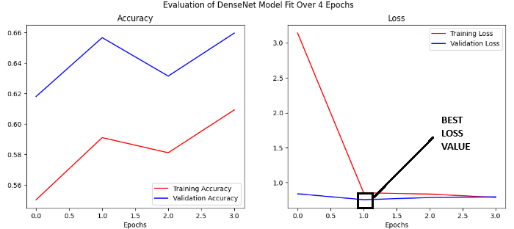
Model Evaluation
Two Neural Network Models:
CNN from scratch:
49% validation accuracy
Pretrained DenseNet:
66% validation accuracy
Notes:
When to comes to model evaluation, we tested two models.
A Convoluted Neural Network (CNN) model built up from scratch layer by layer, and a pretrained model from Keras library.
Keras library has a range of models, we used DenseNet model, one of its advantages is it is slower to discard information or features, while the drawback is that it might be more prone to overfit which is learning training data very closely and not being able to generalize well.

Slide 9
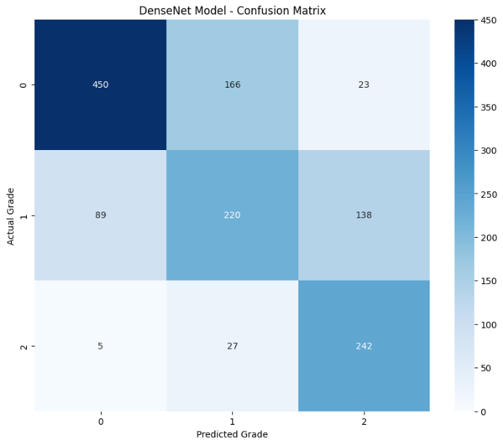
Model Selection
88% of High-Risk Cases Caught
Only 49% of Low-Risk
Notes:
Here we can see how the selected model performed on new our test data
The model did a very good job on high risk cases, which makes sense as visually they are the most distinct group.
While catching 70% of health cases, it classified 26% of healthy cases as low risk.
While low risk case group was hardest group for the model and only 49% of low –risk cases were classified correctly.
Only 49% of cases Low risk cases classified correctly

Slide 10
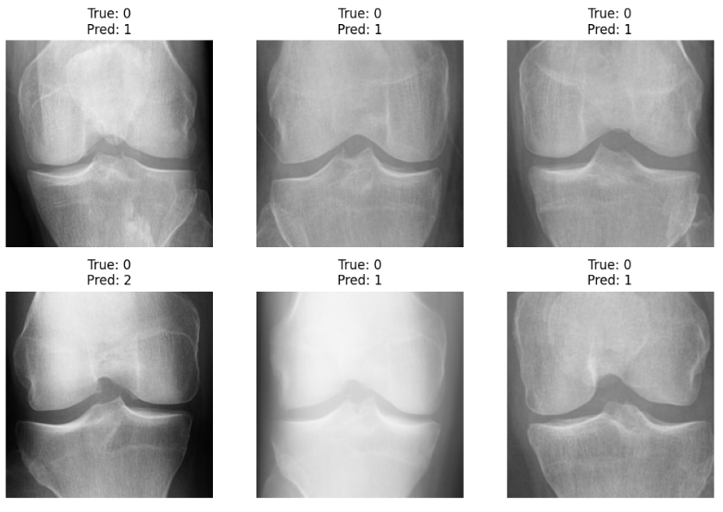
Misclassified Images
More Data
Combining Healthy and Low-Risk
Clustering Low-Risk Images
Notes:
Here we can see some misclassified images.
The model performance can be improved by adding more images, especially as all images are knee x-ray with small differences.
Around 4800 images is not a big number to train model for this purpose.
Another consideration would be to group healthy and low-risk images so that we can focus on creating alert for high-risk cases.
Finally, as low-risk is itself a range it will be interesting to see if they are made of clusters of images that can be grouped into two subsequent categories.

Slide 11
Recommendation
Add an Osteoarthritis Grading Score with Knee X Rays
Arthritis is not reversible
Best Remedies: Exercise and Diet
Occupational and Physical Therapists
Notes:
The goal of this project is to catch potential osteoarthritis risk cases early on.
One of the scary components of arthritis is that it is not reversible.
In extreme cases surgery might be required to maintain or slow down the issue.
However most general and often best remedy is exercise followed by diet.
Looking up exercises to do at home and foods to avoid can significantly slow down the decay process.

Slide 12


Thank You
Notes:
Thank you! For your patience and time, Please let me know if I can address any specific questions or provide further information. Thank you!

